Slide 1

SiteManager
“Right people. Right equipment. Right on time.”

Slide 2


Needfinding
Human Computer Interface
Semester Project Phase I
Joseph Koop, Kelvin Gordon, Enrique Garcia

Slide 3
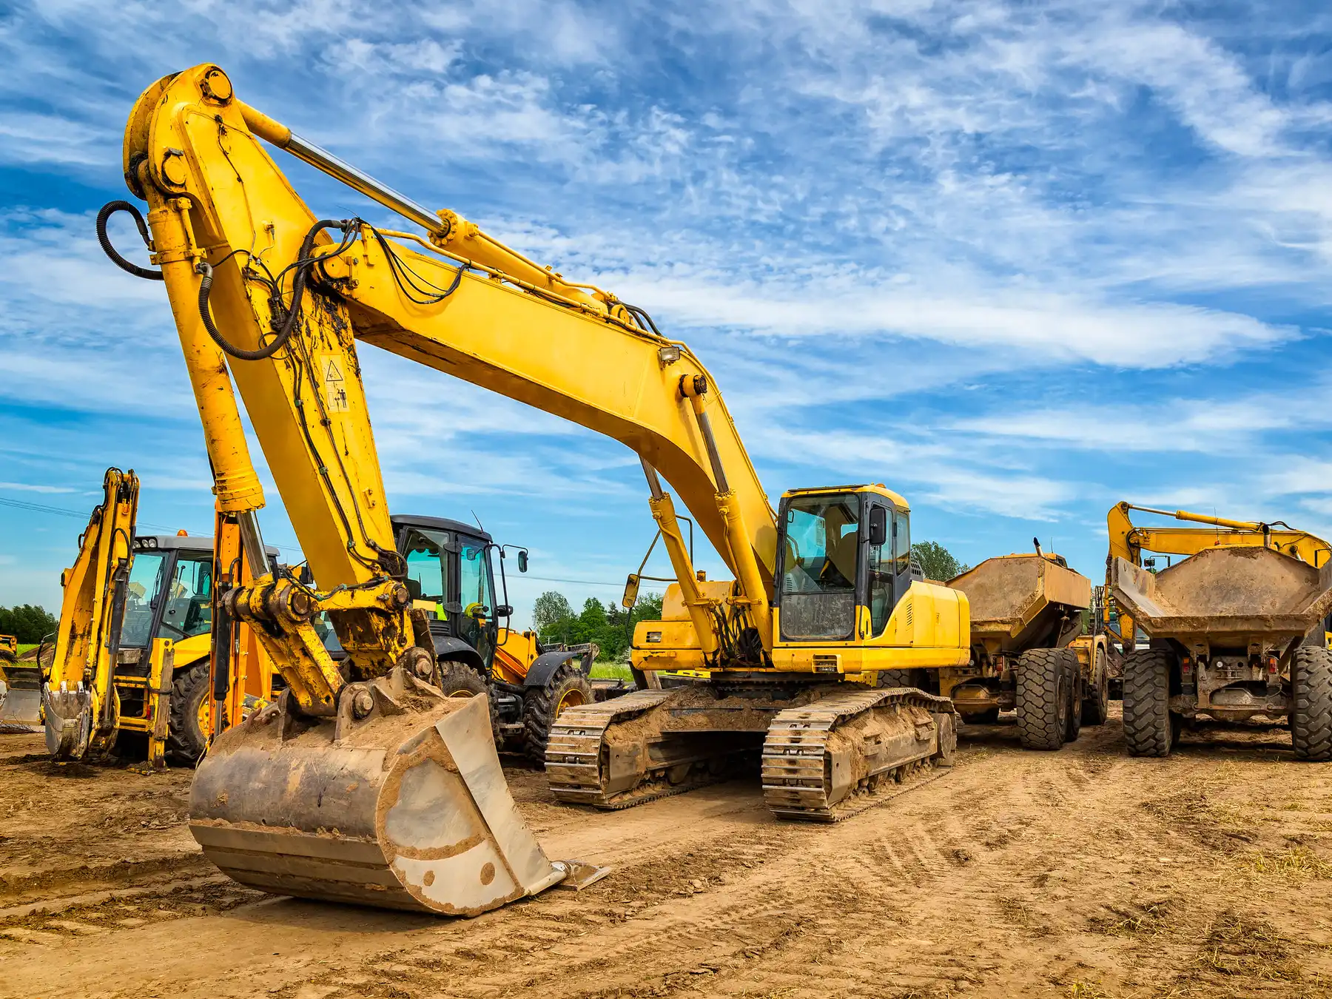
g
Project Domain
Construction Project Tracker for Company Manager
Visual map of project location and completion
Links employees and equipment to current projects

Slide 4
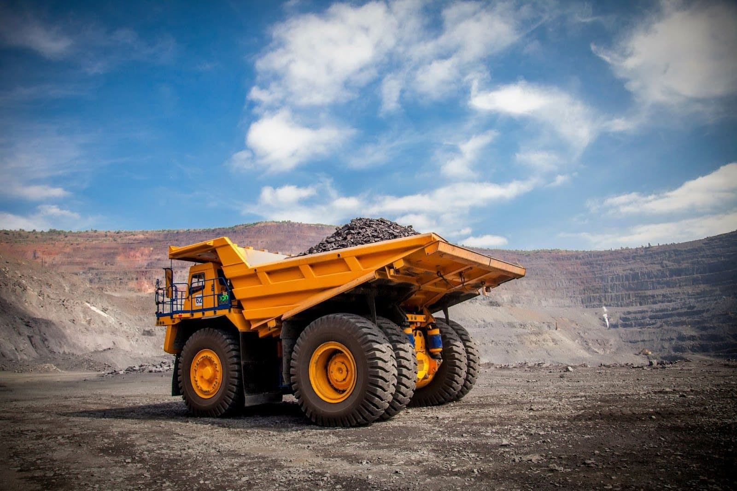

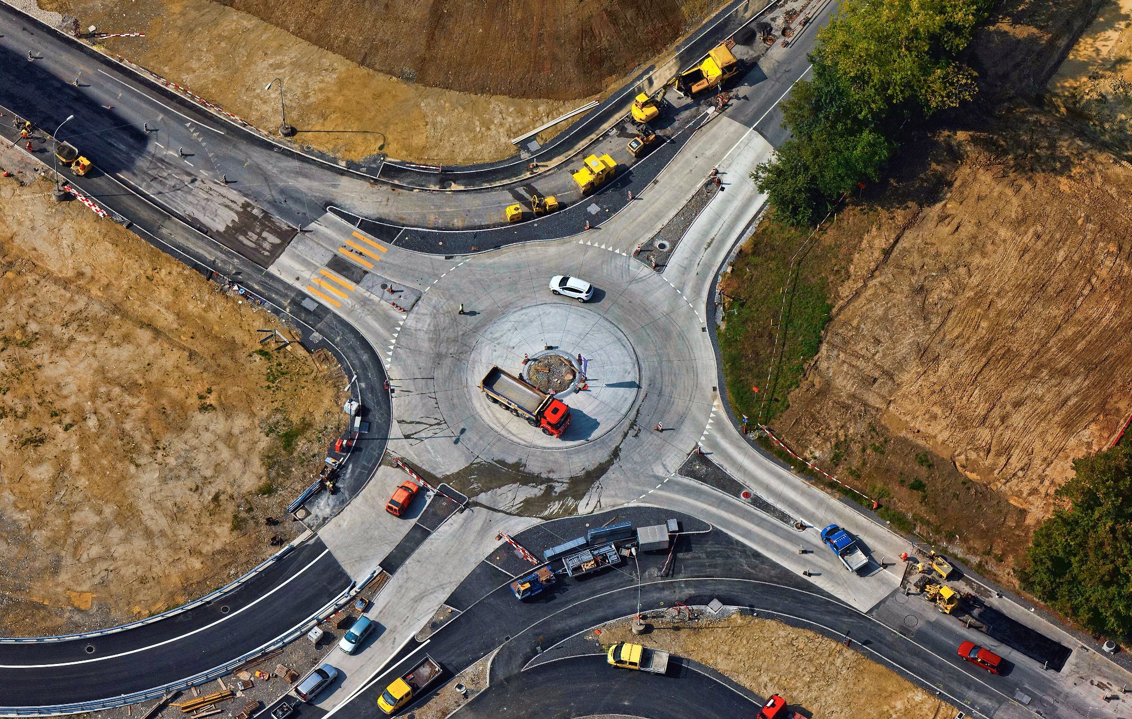
The system:
Heavy Equipment
Active Employees
Current Projects

Slide 5
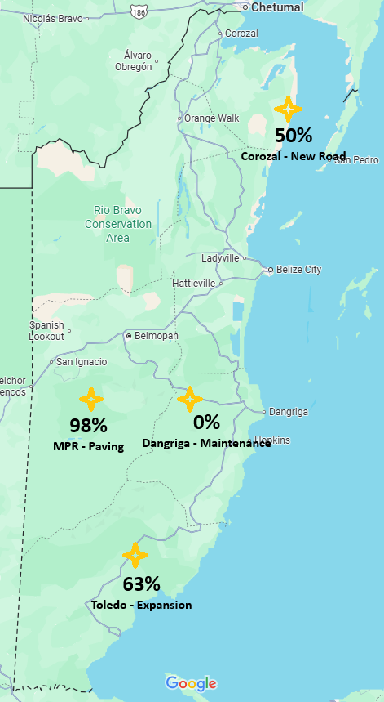
The Map
Lists all ongoing projects
Shows completion %
Links to separate project pages

Slide 6
Scalability
​​
Live tracking instead of assigned tracking
Check if employees clocked in
Trackers on vehicles/equipment
Output data to government or public
Construction hazards
Road conditions/deterioration state
Notes:
Not only assigned, but current

Slide 7
Methodology (Questions Asked)
​​
How do you currently track employees and equipment across different projects?
What are the biggest challenges you face in managing multiple projects at once?
How do you keep track of project progress and deadlines right now?
What kind of system would be valuable to your company?
Notes:
Not only assigned, but current

Slide 8
(More Questions Asked..)
​​
How do you decide which employees and equipment go to which project?
Do you have a system that tracks current and completed projects?
How do you measure the percentage of project completion today?
What features would make you actually use an app like this?
Notes:
Not only assigned, but current

Slide 9


Interviewees
Gideon Banman (Banman Earthmoving operator)
Delroy Banman (Belize Roadway Construction foreman)

Slide 10
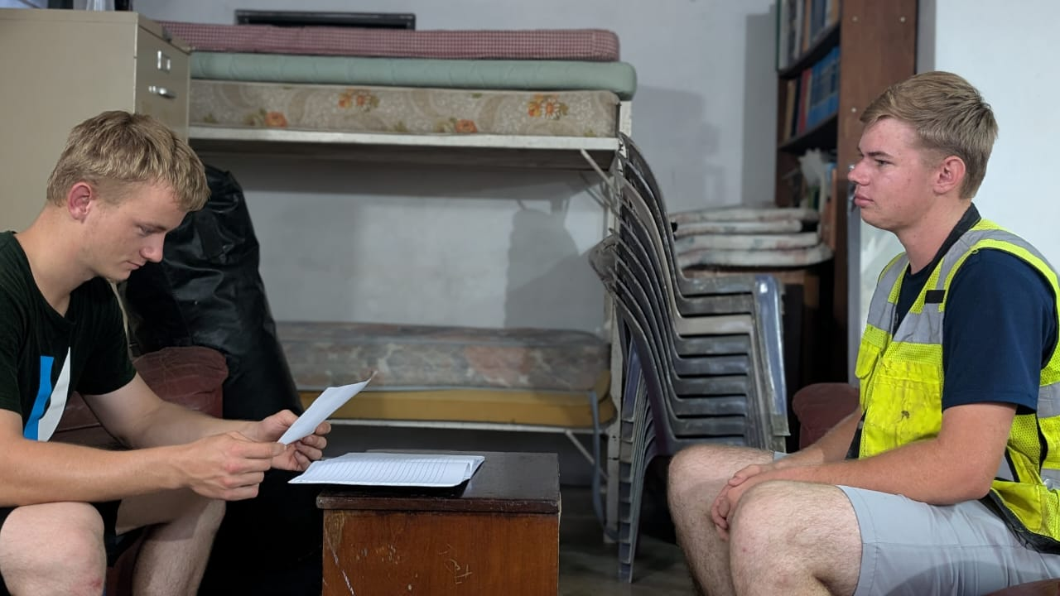
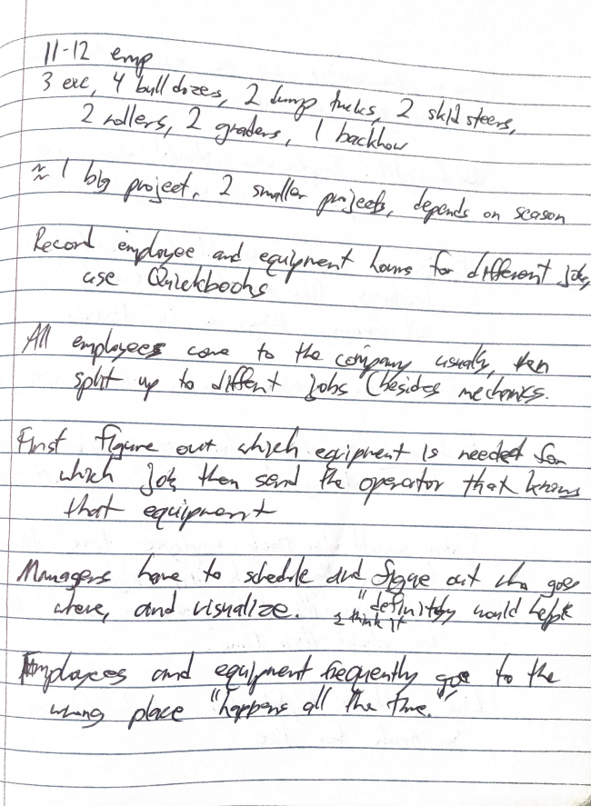
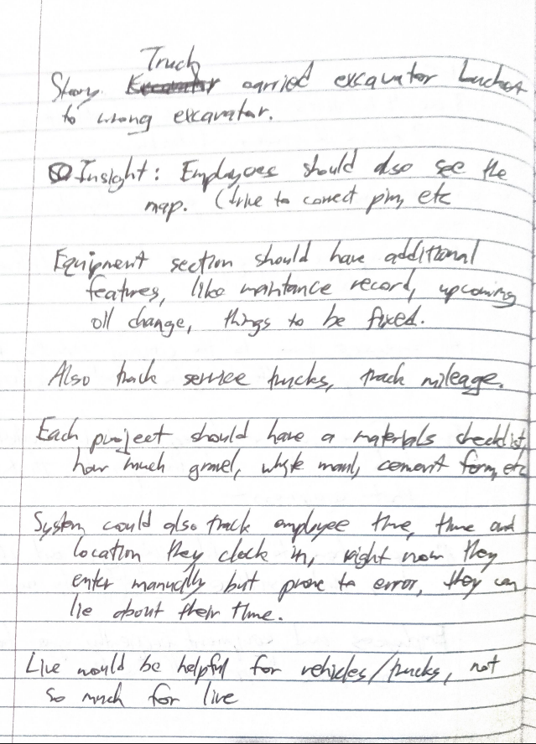
Gideon Banman
5:30 PM, Sep 4, 2025
Friend’s basement
Equipment operator at Banman Earthmoving
Granted interview upon asking

Slide 11
Needs #1
​​
Employees should also view map (delivery equipment and material to right place)
Equipment section should have more features, like tracking maintenance record and upcoming oil changes
Each project should have a materials list, not only employees and equipment
Notes:
Not only assigned, but current

Slide 12
Insights #1
​​
Employees and equipment frequently get sent to wrong location
Would be helpful if managers had a visual map to plan
Tracking employee work time would be beneficial for this company
Live map / Project completion percentage not a priority
Notes:
Not only assigned, but current

Slide 13

​​
EMPATHY MAP
Notes:
Not only assigned, but current

Slide 14


SAY
​​
“I think it would definitely help”
Project tracking not very detailed in company
Misplacement “happens all the time”
Notes:
Not only assigned, but current

Slide 15

DO
​​
Story of a driver carrying bucket to wrong excavator
Differentiated between helpful and unhelpful ideas
Provided valuable feedback on suggestions
Notes:
Not only assigned, but current

Slide 16

THINK
​​
Had many ideas for project features
Allocating resources at least somewhat taxing
Surprise
Employees might be submitting exaggerated times
Tension
Notes:
Not only assigned, but current

Slide 17

FEEL
​​
Felt like the project could be very useful
Project and equipment pages should be expanded
Seemed excited about certain features
Notes:
Not only assigned, but current

Slide 18
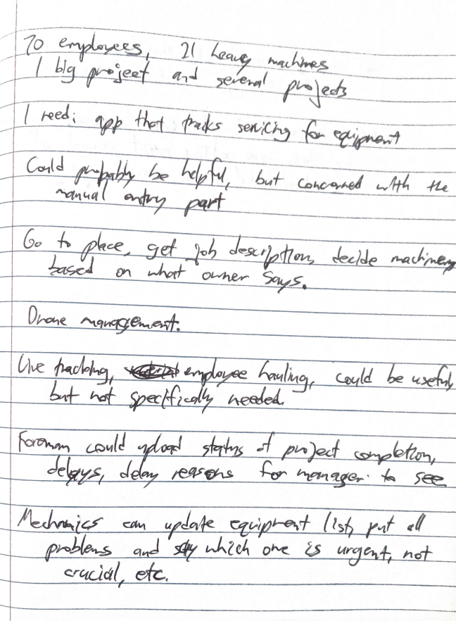
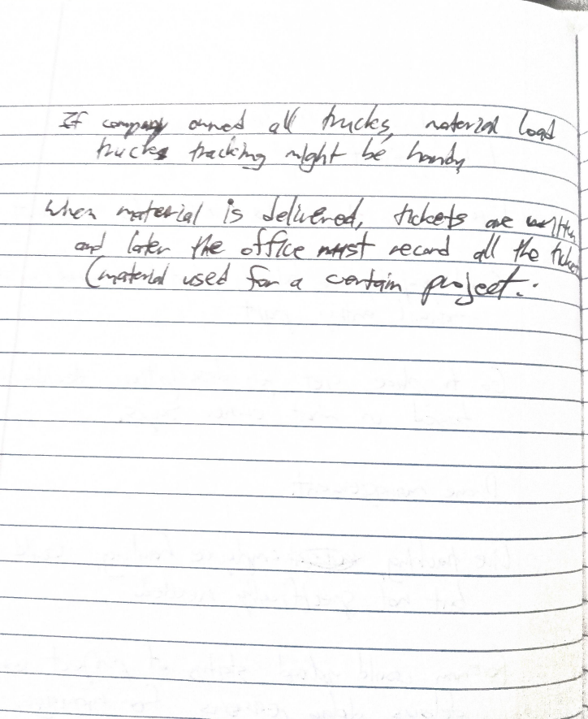
Delroy Banman
7:45 PM, Sep 4, 2025
His house
Construction foreman at Belize Roadway Construction
Granted interview upon asking

Slide 19
Needs #2
​​
Mechanics can track equipment condition in the app, listing issues and the severity of each
Foreman could upload day’s work results, including any delays and the reason for each
Notes:
Not only assigned, but current

Slide 20
Insights #2
​​
Most features seemed like they could be useful, but not worth implementation
Material recording system seemed very inefficient, still paper-based and double-recorded
Anything involving manual entry was frowned upon
Notes:
Not only assigned, but current

Slide 21
​​
EMPATHY MAP
Notes:
Not only assigned, but current

Slide 22
SAY
​​
“It could be useful but . . . ”
Second vote for equipment maintenance tracking
Live tracking / Routing system could come in handy
Notes:
Not only assigned, but current

Slide 23
DO
​​
Was searching for ideas
Many ideas didn’t strike much enthusiasm
Examined ideas critically, to-the-point
Notes:
Not only assigned, but current

Slide 24
THINK
​​
Anything requiring manual tracking not the greatest
Resource allocation not a hassle
Many features might work but not worth implementing
Notes:
Not only assigned, but current

Slide 25
FEEL
​​
The company already had good project control
On-site management can be superior to systems
Tension
Excited at thought of a drone management system
Surprise
Notes:
Not only assigned, but current

Slide 26
Summary
​​
2 interviews were conducted
Many new features not previously considered were brought up by the interviewees that might not have been thought of otherwise
Exact features desired depended on company
Notes:
Not only assigned, but current

Slide 27
​​
The End

